Slide 1
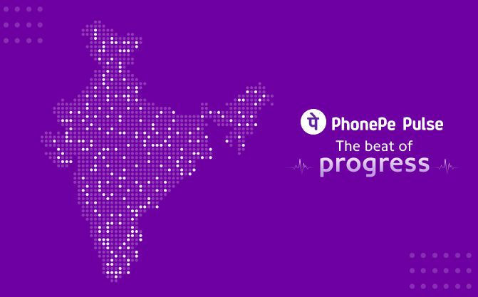
PHONEPE TRANSACTION INSIGHTS

Slide 2
OBJECTIVE
The Objective of this project is to analyze Phonepe transaction data to uncover insights into digital payment trends, insurance adoption, and market expansion opportunities across Indian states.

Slide 3
TOOLS & TECHNOLOGIES
Tools | Used Reason
Python | Data Extraction & Data Cleaning
MySQL | Data Analysis
VS Code | Data Visualization
Streamlit | Dashboard Creation

Slide 4
DATASET OVERVIEW
Table Name | Description
Aggregated Transaction | Yearly & Quarterly Phonepe transaction data
Map Transaction | State/District level transaction details
Aggregated Insurance | Insurance policy data
Aggregated User | User and device based metrics

Slide 5
PROJECT OVERFLOW
1. Data Extraction
2. SQL Queries
3. Visualization
4. Streamlit
5. Insights & Presentation

Slide 6
BUSINESS CASE OVERVIEW
Case No | Business Case | Focus
1 | Decoding Transaction Dynamics | State & Category trends
2 | Insurance Penetration Growth | Policy adoption by state
3 | Market Expansion Analysis | Growth & new opportunities
4 | Device Dominance & User Engagement | Brand & device share
5 | Insurance Transaction Analysis | Yearly transaction insights

Slide 7
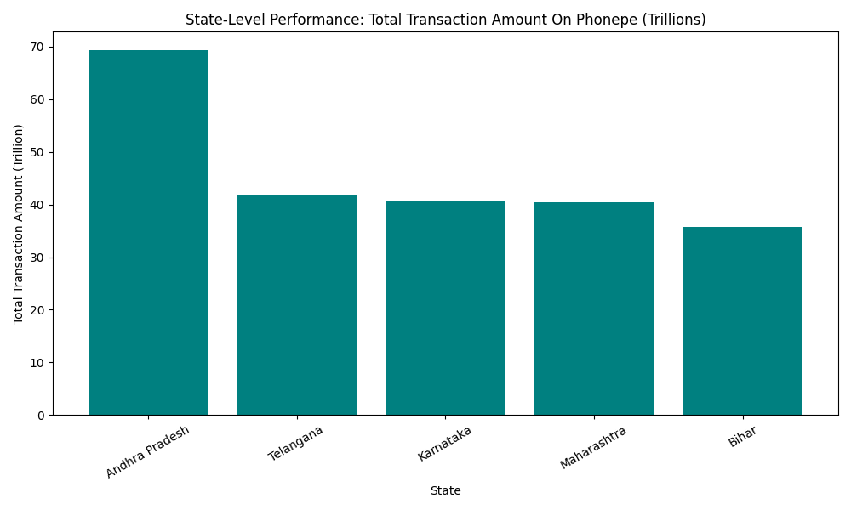
CASE 1 DECODING TRANSACTION DYNAMICS
STATE LEVEL PERFORMANCE
Andhra Pradesh recorded the highest total transaction amount (~₹69 trillion), followed by Telangana, Karnataka, Maharashtra, and Bihar. These states collectively dominate PhonePe’s transaction landscape, reflecting robust digital ecosystems and widespread merchant adoption.

Slide 8
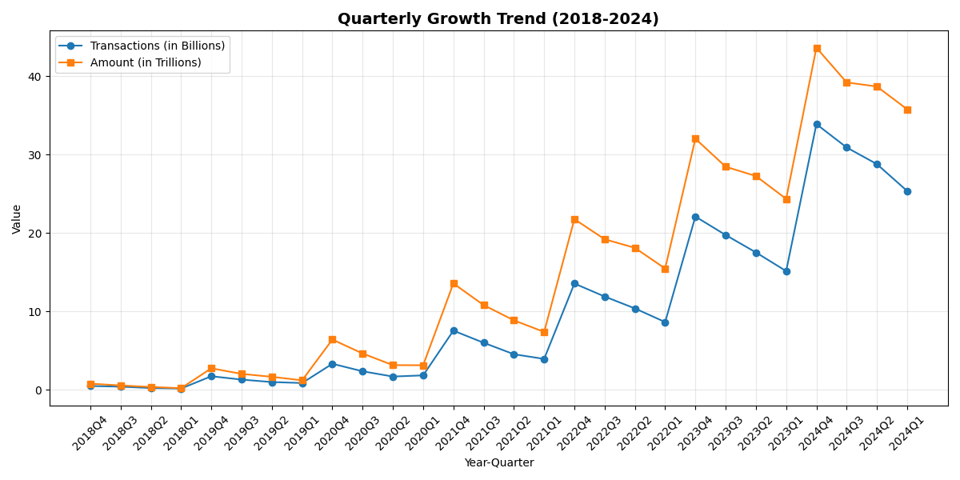
QUARTERLY GROWTH TREND
Digital transactions show a steep and consistent rise from 2018 to 2024. Quarterly transactions grew from 0.15 B to 33.9 B , and total transaction value surged from ₹0.19 T to ₹43.6 T. Growth accelerated notably after 2020, reflecting stronger digital adoption and higher-value payments.

Slide 9
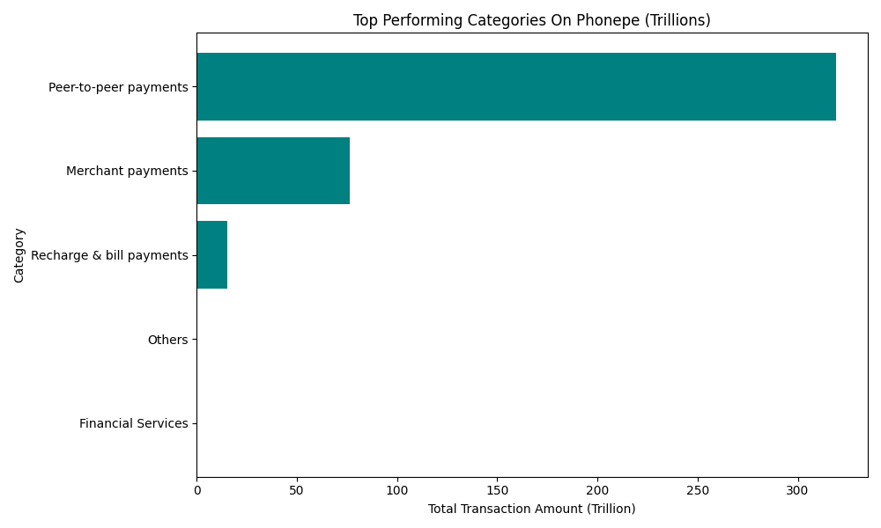
CATEGORY-WISE PERFORMANCE
Among all categories, Peer-to-Peer and Merchant Payments dominate, representing the bulk of PhonePe’s transaction value and count. The strong showing of Recharge & Bill Payments indicates user stickiness for regular transactions, while Financial Services mark a gradual expansion toward digital banking and wealth management.

Slide 10
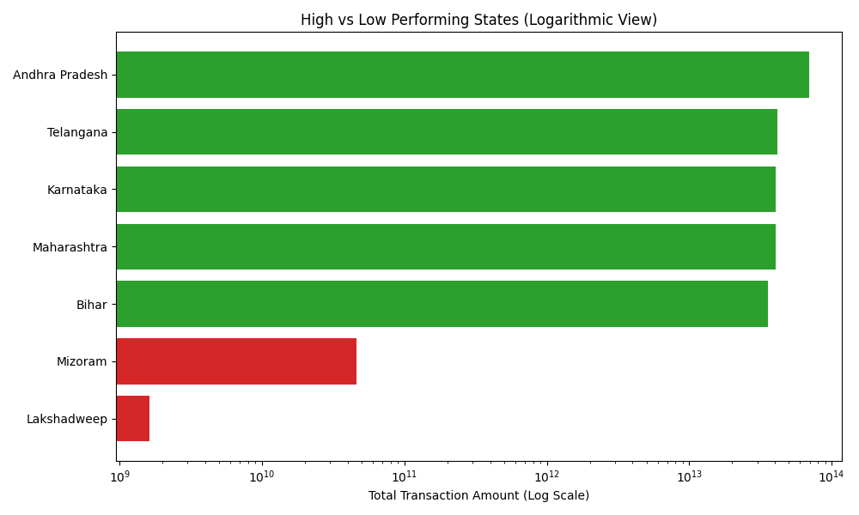
HIGH AND LOW PERFORMING STATES
Andhra Pradesh, Telangana, Karnataka, Maharashtra, and Bihar emerge as PhonePe’s top-performing states, collectively contributing the majority of India’s digital payment value.
In contrast, smaller territories such as Mizoram and Lakshadweep record minimal activity, reflecting digital infrastructure limitations. Bridging this gap through targeted digital literacy and merchant expansion strategies could unlock significant new transaction volumes for PhonePe.

Slide 11
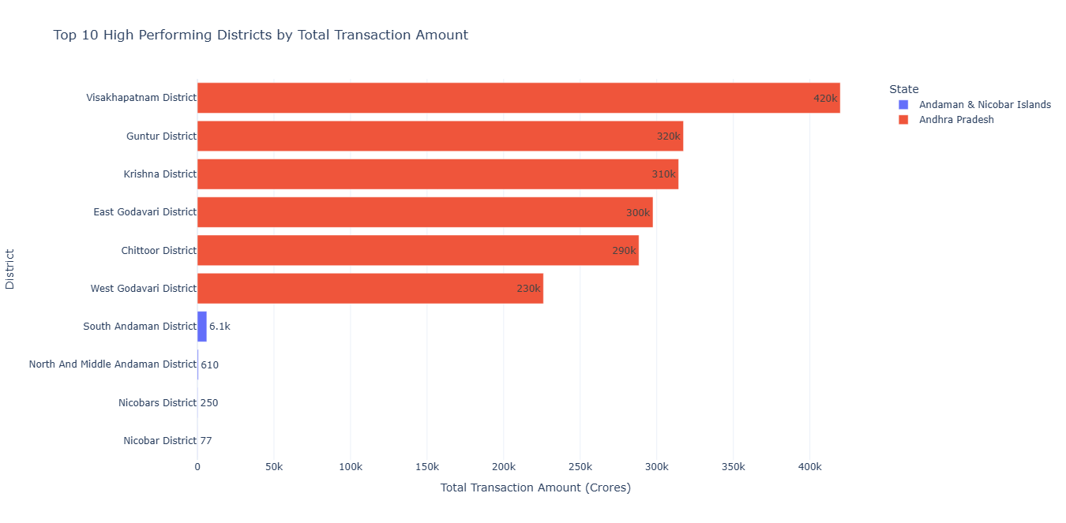
DISTRICT LEVEL PERFORMING ANALYSIS
Visakhapatnam District clearly leads with over ₹4.2 lakh crore in digital transactions, followed by Guntur and Krishna.
Andhra Pradesh dominates the top 10, highlighting its strong digital transaction ecosystem, while the Andaman districts appear much lower, showing limited activity.

Slide 12
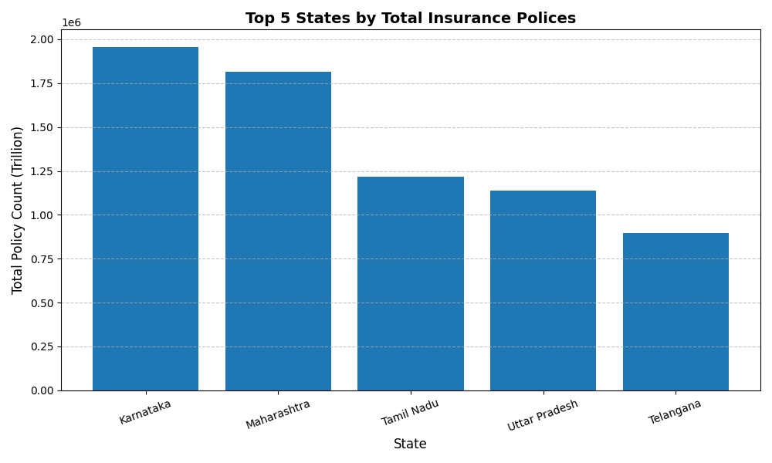
CASE 2 INSURANCE PENETRATION & GROWTH
TOP STATES BY INSURANCE POLICIES
The analysis of insurance policy counts across India shows that Karnataka and Maharashtra are leading contributors to digital insurance adoption via PhonePe. Southern states demonstrate significant penetration, while northern states like Uttar Pradesh show strong growth potential, making them key focus areas for future expansion strategies.

Slide 13
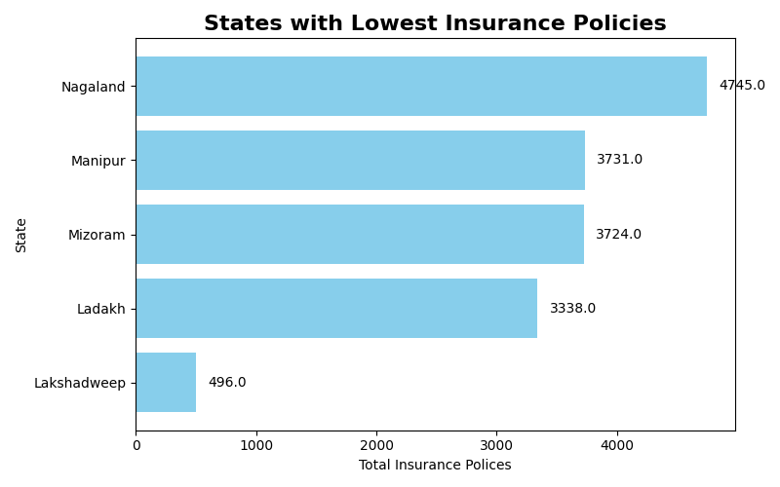
STATES WITH LOWEST INSURANCE
The states of Lakshadweep, Ladakh, and parts of Northeast India exhibit minimal insurance penetration, indicating limited access to digital financial services. These regions represent high potential zones for targeted inclusion efforts and strategic expansion by fintech and insurance providers to boost national-level insurance coverage.

Slide 14
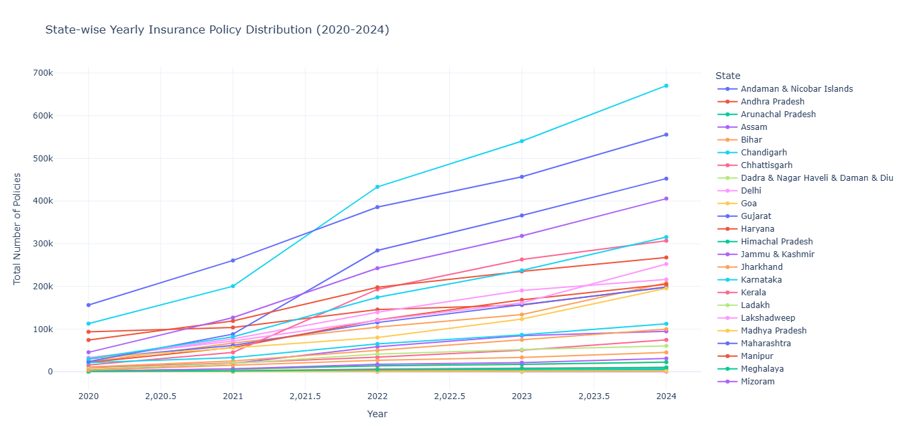
STATE-WISE YEARLY INSURANCE POLICY
DISTRIBUTON ANALYSIS
The number of insurance policies increased steadily across all leading states between 2020–2024.
Karnataka recorded the highest growth, followed by Maharashtra and Tamil Nadu, reflecting strong insurance market expansion in the southern region.

Slide 15
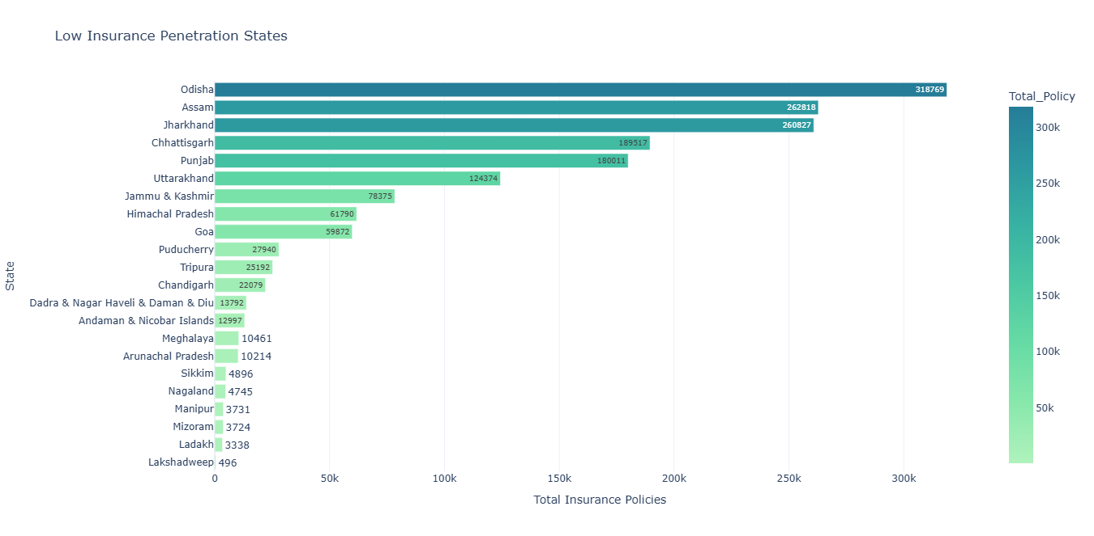
LOW PENETRATION STATES
States like Lakshadweep, Ladakh, Mizoram, and Manipur have the lowest insurance policy penetration in India, each recording fewer than 5,000 total policies.
This indicates limited insurance awareness and accessibility in northeastern and union territory regions, calling for targeted financial inclusion programs.

Slide 16
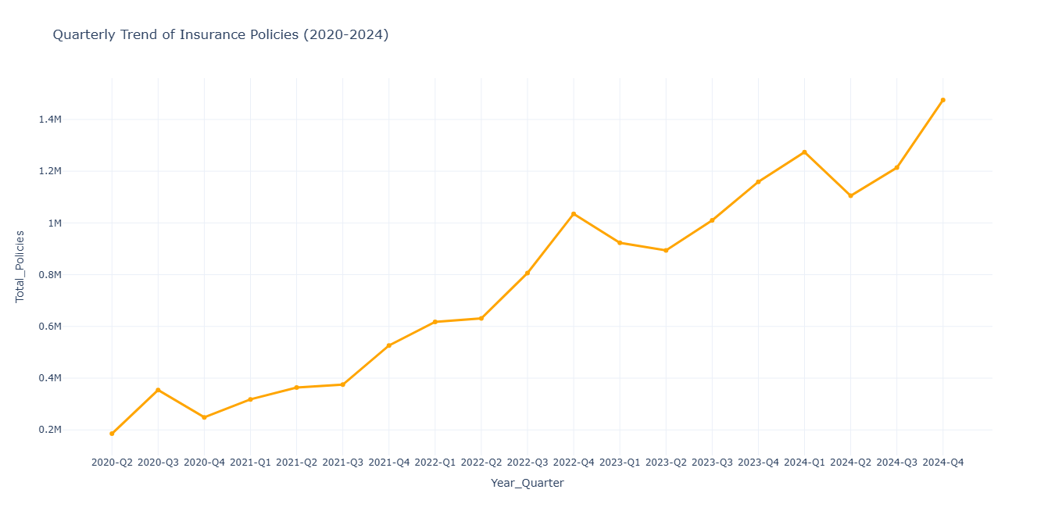
QUARTERLY TREND ANALYSIS
Insurance policy adoption shows a consistent upward trend from 2020 to 2024.
Quarterly policies grew from 0.18 million in 2020-Q2 to 1.47 million in 2024-Q4, reflecting steady market expansion and increased insurance awareness post-2021.
Slight dips are seen in early quarters of some years, indicating possible seasonal variations.

Slide 17
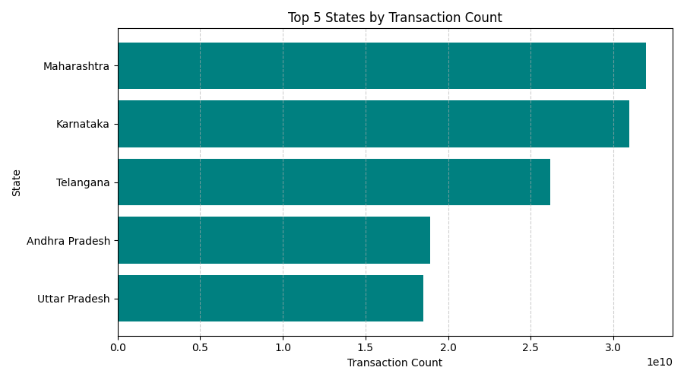
CASE 3 TRANSACTION ANALYSIS FOR MARKET
EXPANSION
TRANSACTION VOLUME BY STATE
Maharashtra records the highest total transactions, followed closely by Karnataka and Telangana, showing strong fintech adoption in southern and western India.
Andhra Pradesh and Uttar Pradesh complete the top five, reflecting growing digital payment penetration across high-population states.

Slide 18
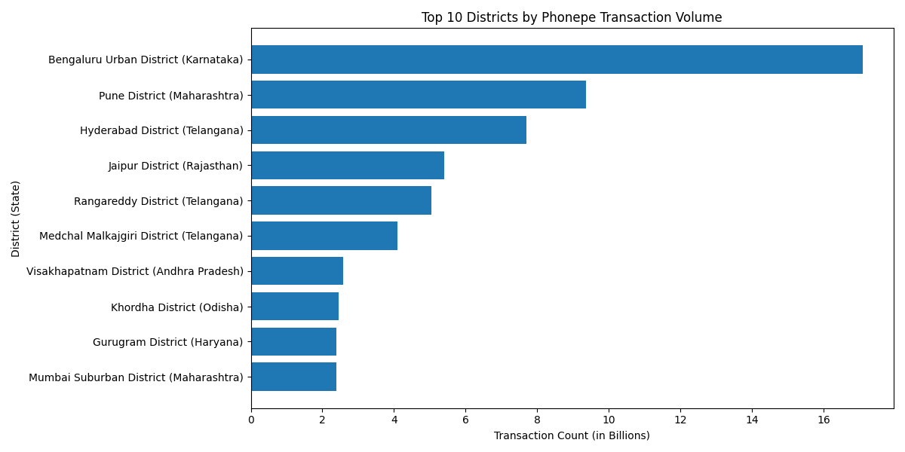
TOP DISTRICTS BY TRANSACTION VALUE
Bengaluru Urban leads India in PhonePe transactions, followed by Pune and Hyderabad.
Southern and metro districts dominate overall, showing strong digital payment adoption, while Tier-2 cities like Jaipur are rapidly catching up.

Slide 19
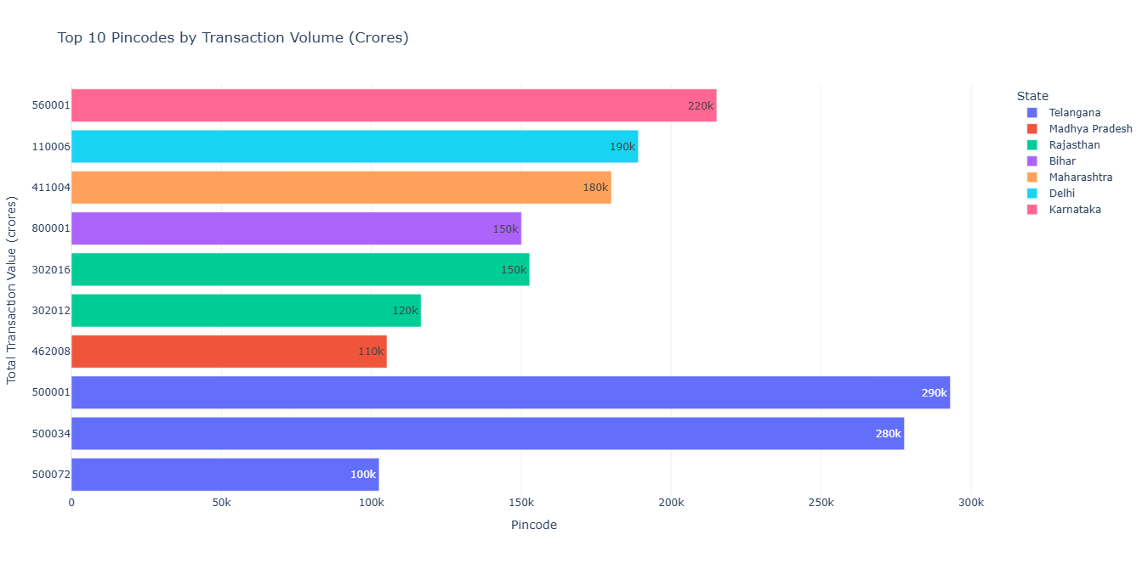
TOP PINCODES BY TRANSACTION VALUE
The top 10 pincodes show exceptional transaction volumes, with Telangana (500001, 500034) and Karnataka (560001) dominating digital payments.Urban and metropolitan pincodes clearly outperform, reflecting higher adoption and spending power in major cities.

Slide 20
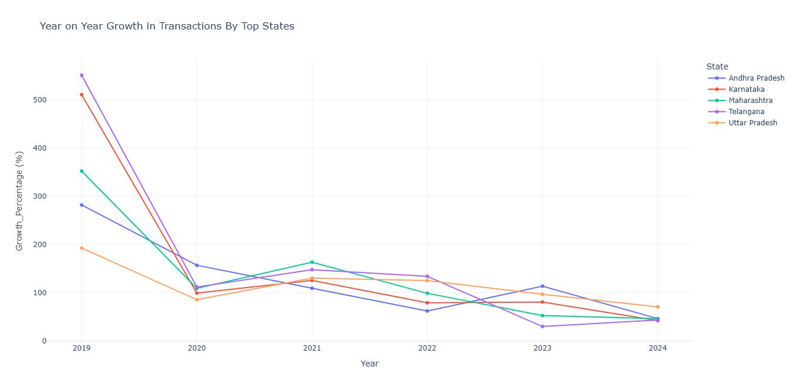
YEAR ON YEAR GROWTH IN
TRANSACTION BY STATES
The Year-on-Year growth trend reveals rapid expansion in digital transactions across states from 2018–2021, followed by stabilization post-2022.
States like Telangana, Karnataka, and Maharashtra exhibited early explosive growth exceeding 100–500% YoY, while growth rates have gradually normalized, indicating market maturity and wider adoption of digital payment systems.

Slide 21
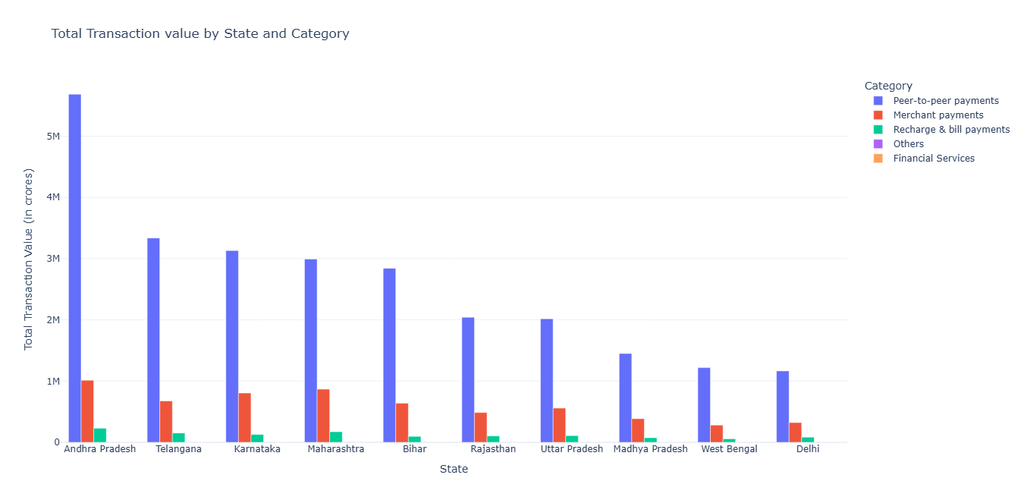
TRANSACTION VALUE BY STATE AND
CATEGORY
Peer-to-Peer (P2P) payments dominate the digital transaction landscape, especially in Andhra Pradesh, Telangana, and Karnataka, each exceeding ₹3–5 lakh crores.
Merchant payments follow as the second-largest contributor, indicating a steady rise in commercial digital adoption.
States like Maharashtra and Tamil Nadu show a balanced mix across all categories, reflecting mature digital ecosystems.

Slide 22
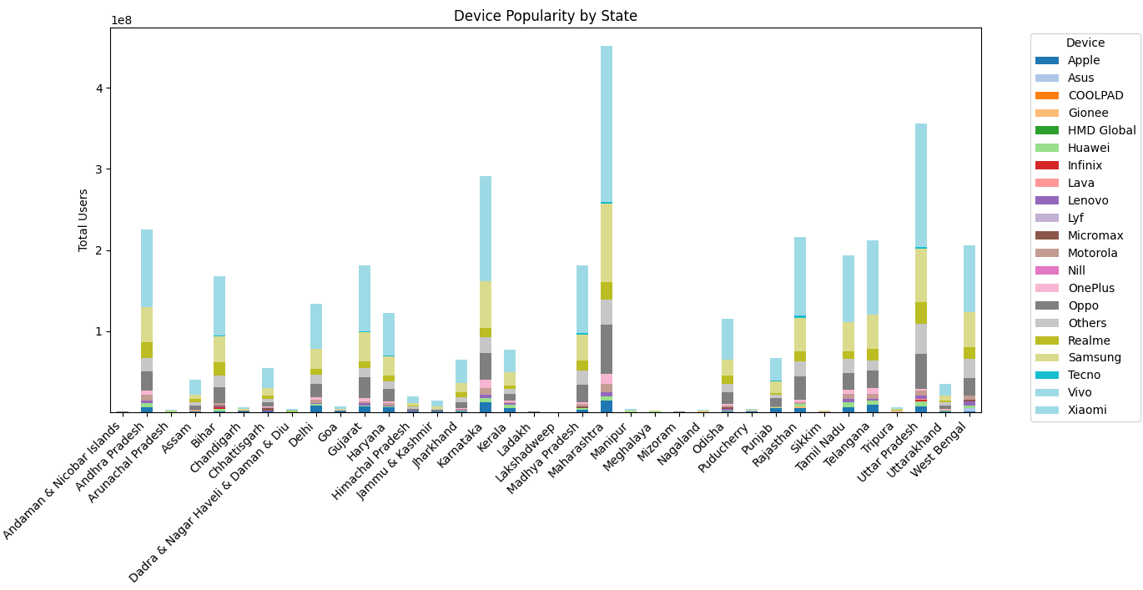
CASE 4 DEVICE DOMINANCE & USER
ENGAGEMENT
DEVICE POPULARITY BY STATE
Analysis of device popularity by state shows Xiaomi as the leading smartphone brand nationwide, followed by Samsung, Vivo, Oppo, and Realme. Apple and OnePlus have limited but significant adoption in metro regions. Budget-friendly Android devices dominate the market, reflecting the demographic trend of mass adoption of affordable smartphones for digital payments.

Slide 23
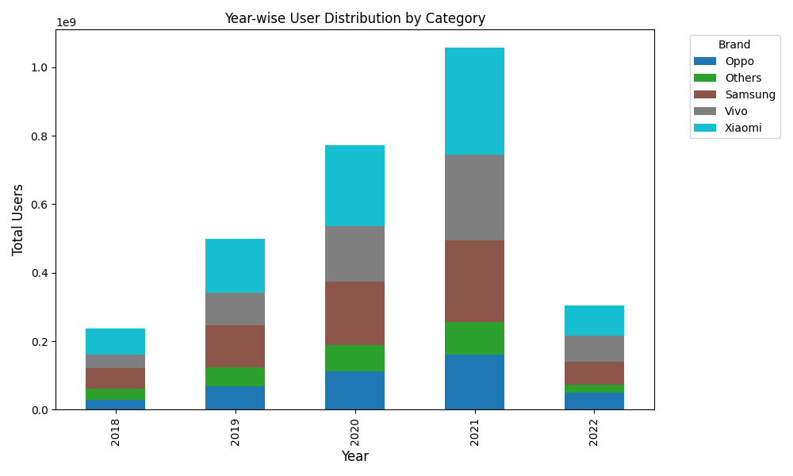
YEAR-WISE USER DISTRIBUTION BY
CATEGORY
Xiaomi consistently leads user adoption on PhonePe from 2018–2022, followed by Vivo and Samsung. The dominance of mid-range Android brands highlights affordability and market reach across India. Gradual user growth each year reflects increasing smartphone-based digital payments penetration.

Slide 24
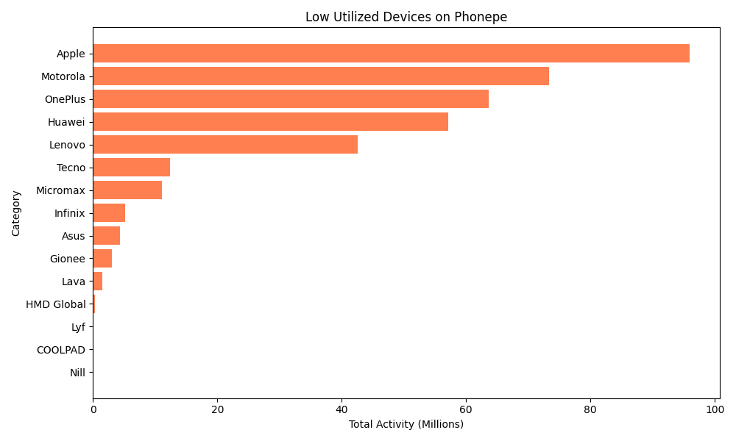
LOW UTILIZED DEVICES
Analysis of low-utilized devices on PhonePe shows that premium devices like Apple, OnePlus, and Huawei, as well as niche and legacy devices like Micromax, Infinix, Lava, and Lyf, contribute below-average activity. This indicates that the bulk of digital payment transactions are concentrated on widely adopted budget and mid-range Android devices.

Slide 25
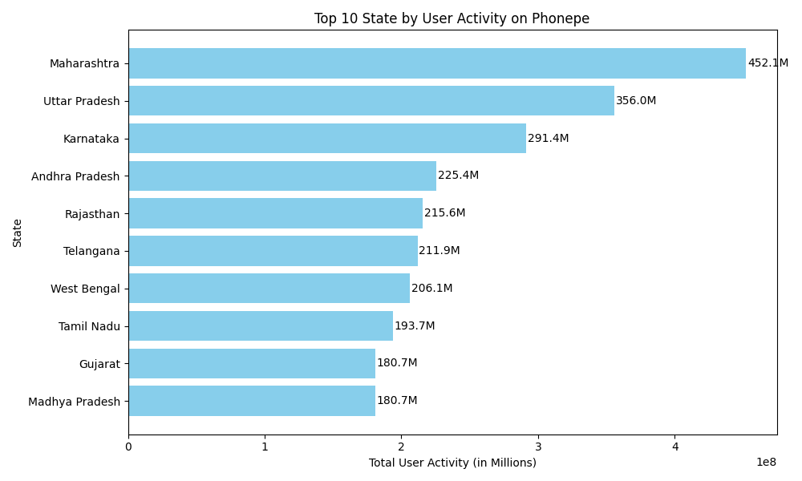
TOP 10 STATES BY USER ACTIVITY
Maharashtra leads in user activity on PhonePe, followed by Uttar Pradesh and Karnataka.
High engagement in southern and western states highlights stronger digital adoption, while usage in smaller states remains comparatively low.

Slide 26
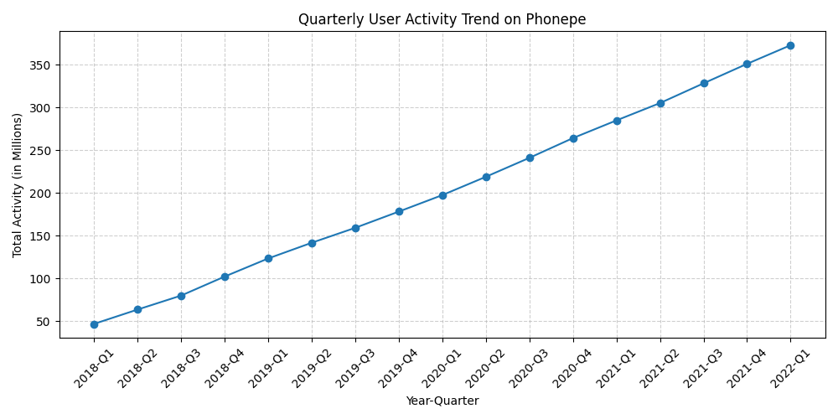
QUARTERLY ACTIVITY
Quarterly PhonePe activity shows strong, consistent growth from 2018 to 2021, with user activity increasing each quarter. Peak activity occurs in Q4 of each year, reflecting seasonal and festival-driven usage. Overall, the trend highlights rapid adoption of digital payments in India over the four-year period.

Slide 27
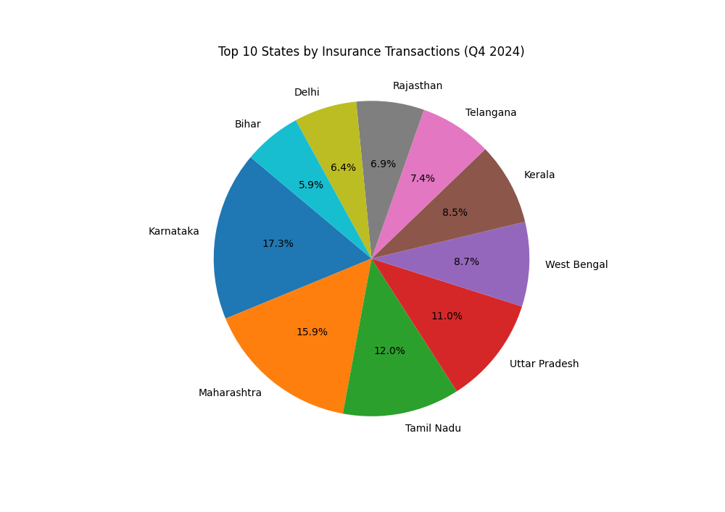
CASE 5 INSURANCE TRANSACTION
ANALYSIS
INSURANCE TRANSACTION BY STATE
Karnataka, Maharashtra, and Tamil Nadu are the highest contributors to insurance transactions.
These states are likely to have higher insurance adoption due to urbanization, financial literacy, and insurance penetration.

Slide 28
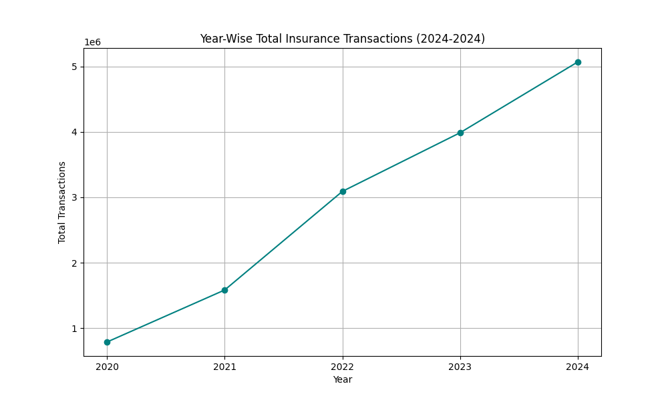
YEAR-WISE INSURANCE
TRANSACTIONS
Steady increase from 2020 → 2024, showing rapid adoption of insurance. Clear upward trajectory; reflects rising digital insurance usage and expanding market opportunities.

Slide 29
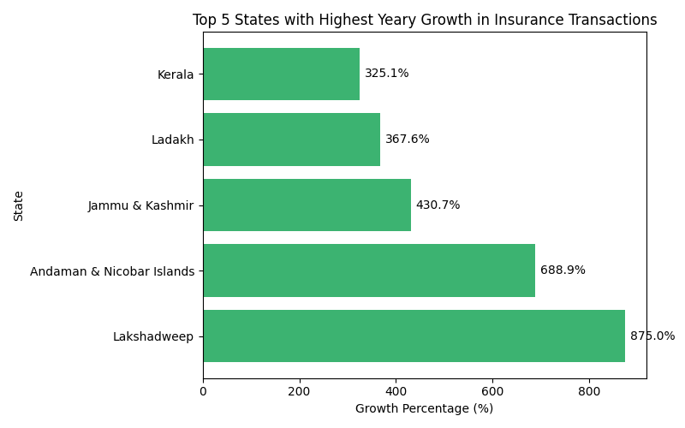
TOP STATES WITH HIGHEST GROWTH IN
TRANSACTION IN A YEAR
Lakshadweep and Andaman & Nicobar Islands saw exceptional insurance transaction growth (875% and 689%) — a sign of rapid digital adoption from a low base. Jammu & Kashmir and Ladakh also demonstrated strong growth post-2020.Kerala’s 325% surge in 2022 indicates expanding insurance awareness and digital penetration in mature markets.

Slide 30
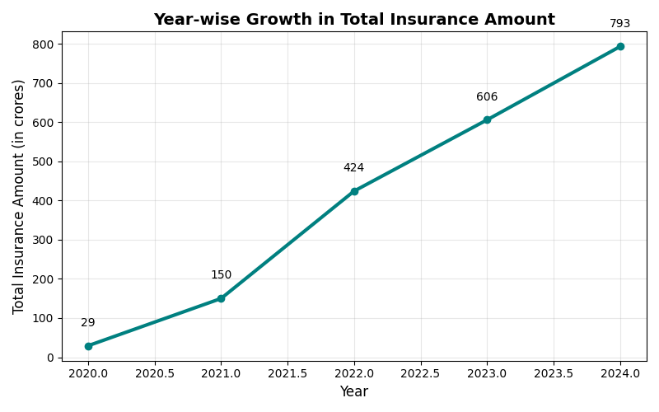
TOTAL INSURANCE AMOUNT OVER
YEARS
Indicates expanding insurance adoption and larger transaction amounts. Rising trend reflects digital penetration and financial inclusion in India.

Slide 31
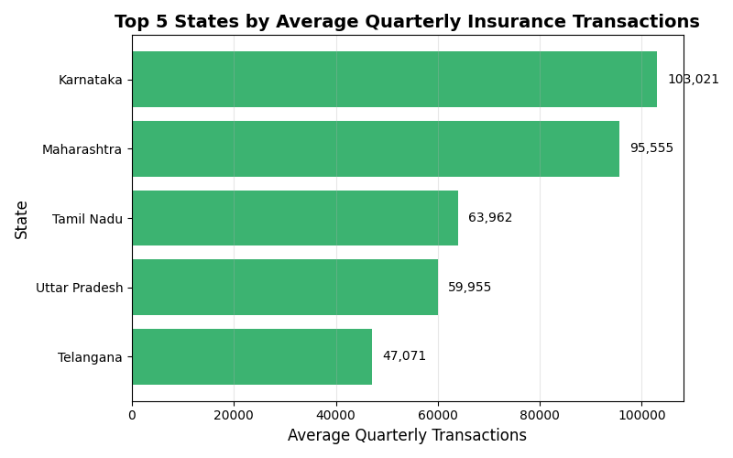
TOP STATES BY AVERAGE QUARTERLY
GROWTH
Karnataka leads with the highest average quarterly insurance transactions, followed by Maharashtra and Tamil Nadu. The dominance of these states indicates strong insurance adoption and higher digital penetration in southern and western India.

Slide 32
STREAMLIT DASHBOARD

Slide 33
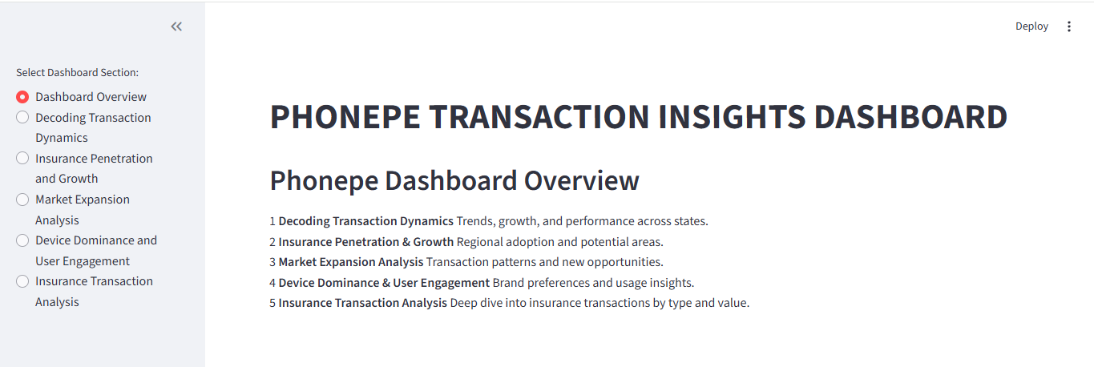

Slide 34
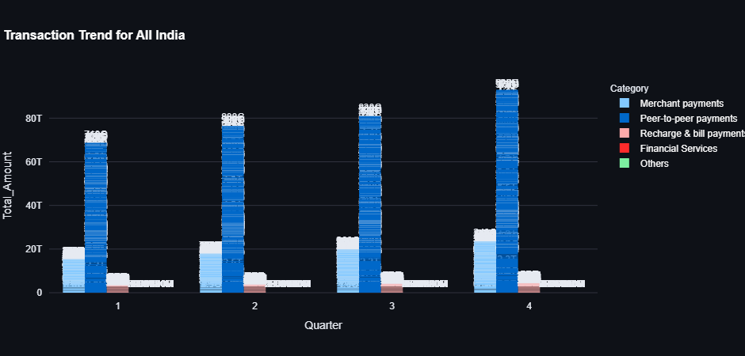
TRANSACTION TREND FOR ALL INDIA

Slide 35
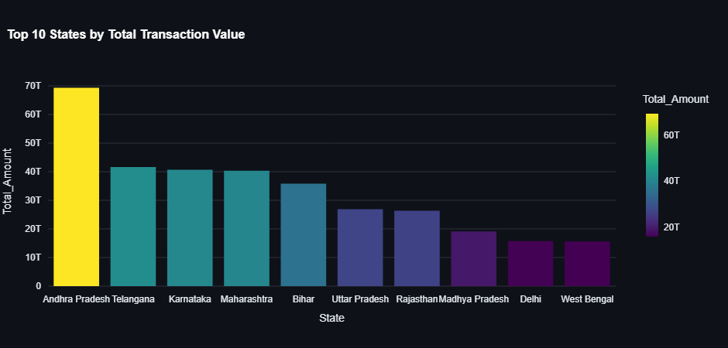
TOP 10 STATES BY TRANSACTION VALUE

Slide 36
INSIGHTS
Southern states like Andhra Pradesh, Telangana, and Karnataka lead transaction volumes.
Consistent year-on-year growth shows India's increasing digital payment adoption.
Peer-to-peer and merchant payments are dominant across states.

Slide 37
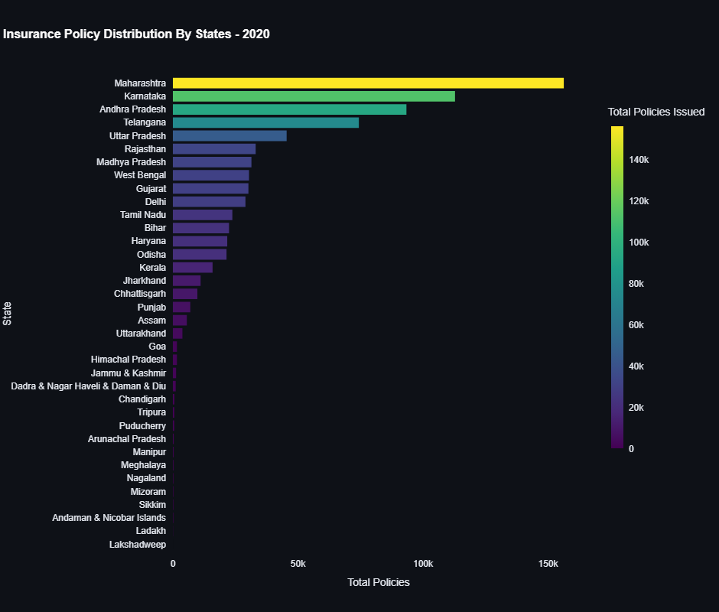
INSURANCE POLICIES BY STATES

Slide 38
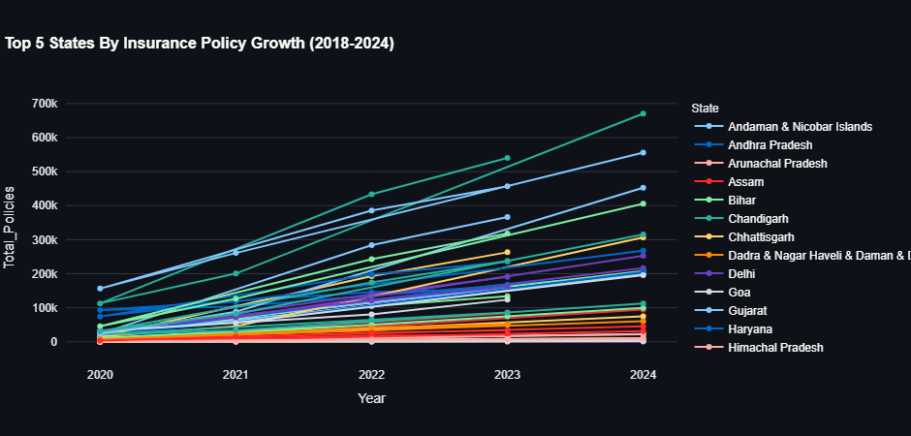
YEARLY GROWTH TREND

Slide 39
INSIGHTS
In {selected_year}, Karnataka, Maharashtra, and Tamil Nadu lead in total insurance policies, confirming high penetration in digitally mature regions.
The horizontal bar chart highlights clear state-wise differences, while the line chart shows consistent multi-year growth patterns among the top performers.

Slide 40
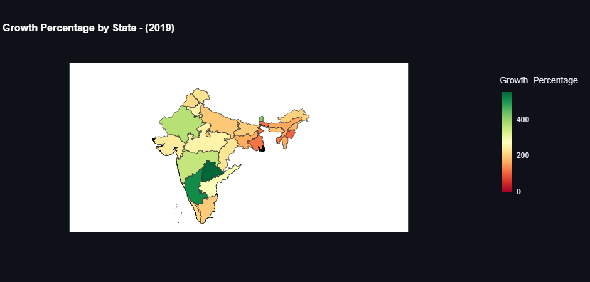
GROWTH PERCENTAGE BY STATE

Slide 41
INSIGHTS
Green regions indicate strong market growth, signaling higher transaction expansion.
Red/Brown regions highlight slower or negative growth, requiring strategic focus.
States like Karnataka, Maharashtra, and Uttar Pradesh consistently show high transaction volumes and stable growth.

Slide 42
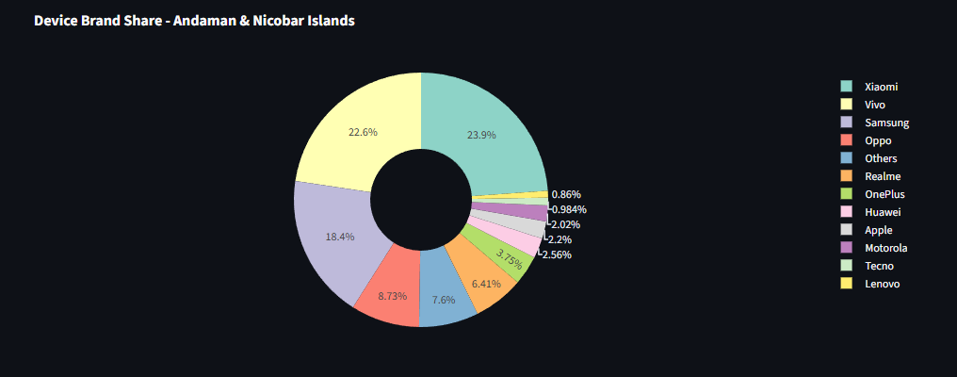
DEVICE BRAND SHARE

Slide 43
INSIGHTS
The pie chart shows which mobile brands dominate PhonePe usage in this state.
Xiaomi, Samsung, and Vivo often lead in user count.
Apple and OnePlus have a stronger share in metro or high-income regions.
Helps identify user engagement patterns based on device brand preference.

Slide 44
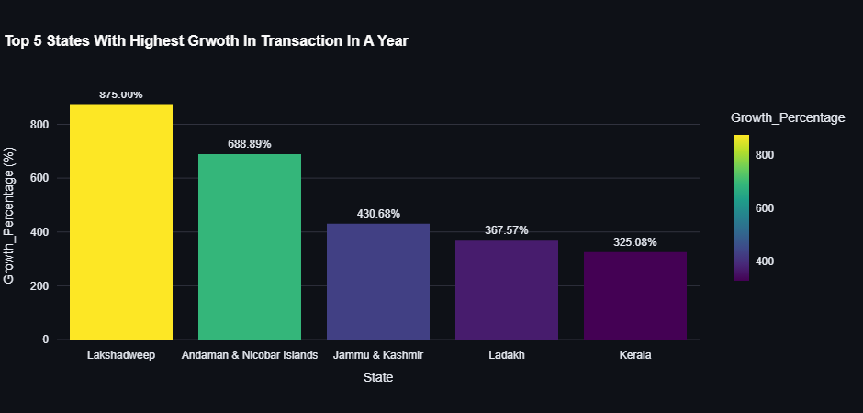
TOP 5 STATES WITH HIGHEST GROWTH IN
TRANSACTIONS IN A YEAR

Slide 45
INSIGHTS
Lakshadweep (875%) and Andaman & Nicobar Islands (688.9%) lead with the sharpest insurance adoption jumps, driven by digital outreach in small populations.
Northern territories like Jammu & Kashmir and Ladakh follow closely, showing increasing integration of insurance into financial habits.
Kerala (325%) reflects strong policyholder expansion, signaling regional trust in digital insurance systems.
The data highlights untapped growth opportunities in smaller or previously underrepresented regions.

Slide 46
PROJECT OUTCOMES
Extracted & cleaned data from MySQL
Created 25 SQL queries for 5 business cases
Built 10+ interactive charts
Designed a dynamic Streamlit dashboard
Derived meaningful insights for PhonePe’s market strategy

Slide 47
CONCLUSION
This project demonstrates how SQL, Python, and Streamlit can be combined to deliver actionable business insights.
The findings reveal strong growth in digital transactions, with clear regional and product-level opportunities for expansion.

Slide 48
REFERENCES
https://github.com/ReginahubJ333/Phonepe-Transaction-Insights

